Slide 1
Project Proposal
NerG (A Door Motion Energy Harvesting System)
Instructed by: Dr. Saniie
ECE 510 Summer 2024
5/22/2024

Slide 2


The Team
Adnan Patel
M.S. Electrical Engineering
Focus in VLSI construct and circuit building.
Abhilash Kashyap Balasubramanyam
Master of Engineering in Artificial Intelligence for Computer Vision and Control

Slide 3

Why
Most people are unaware that a great deal of energy is constantly being generated around them. Energy can be obtained from various sources, including vibrations, thermal and mechanical sources, and so on.
The concept of employing normal hinge doors to harvest energy is relatively new on the energy scene. This green energy solution uses a daily occurrence to generate some electrical energy, which may be used for a wide range of low-powered electronics.
A hinge-mounted rotary motor, acting as a generator, can be used for energy harvesting by aligning the motor shaft with the door hinge axis. The shaft attaches to the stationary hinge side, while the motor housing mounts to the door, enabling relative motion

Slide 4
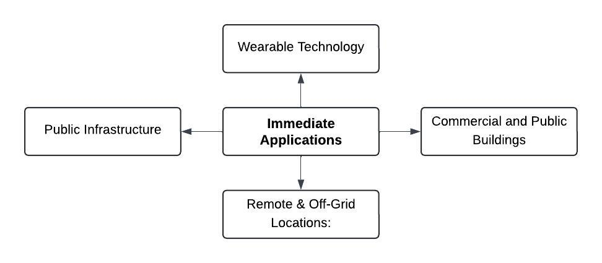
Use case
This form of energy harnessing has a wide range of applications.
As doors is the most basic thing that we use in our day to day life it’s application can be divided into two different types.

Slide 5
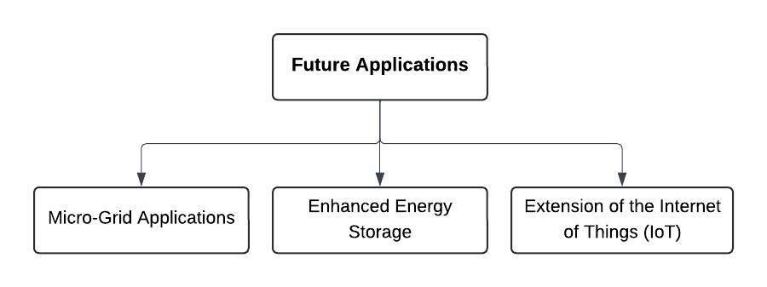
Future Applications

Slide 6
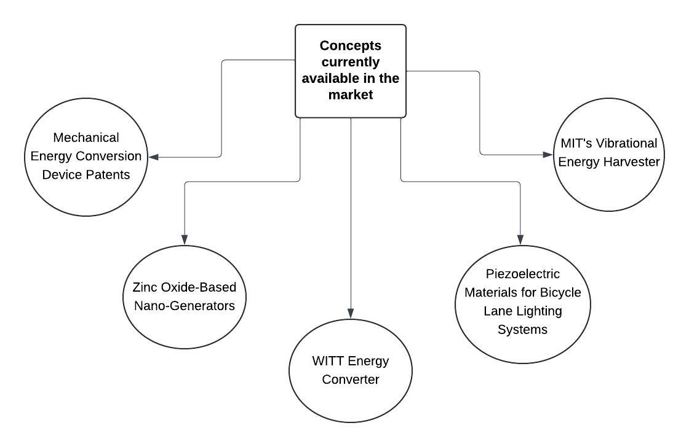
Market Scenario

Slide 7
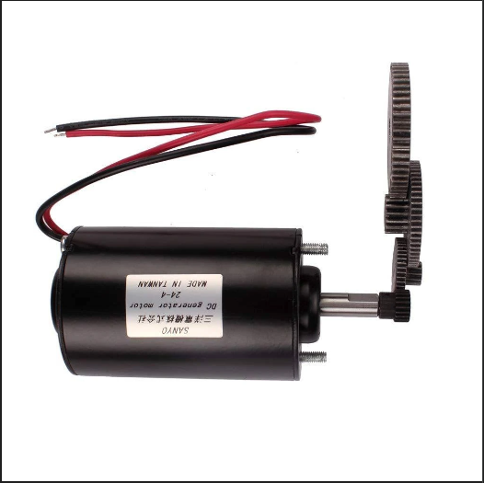
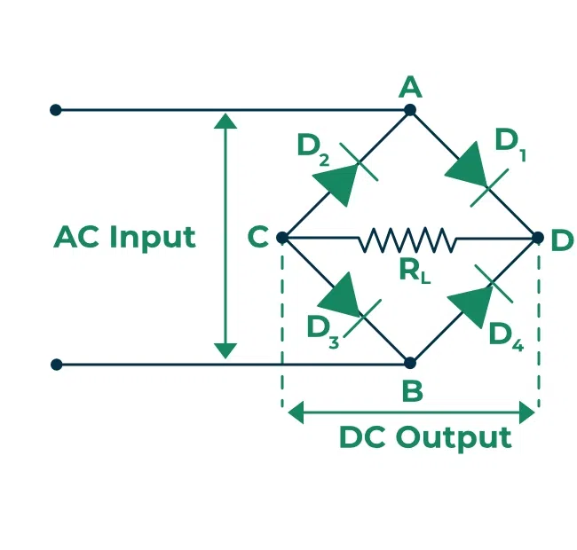
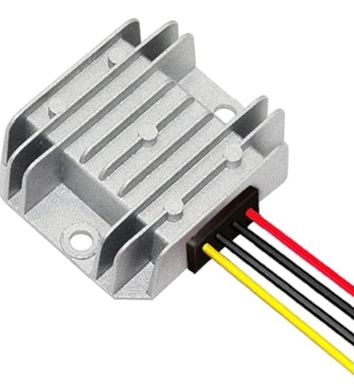
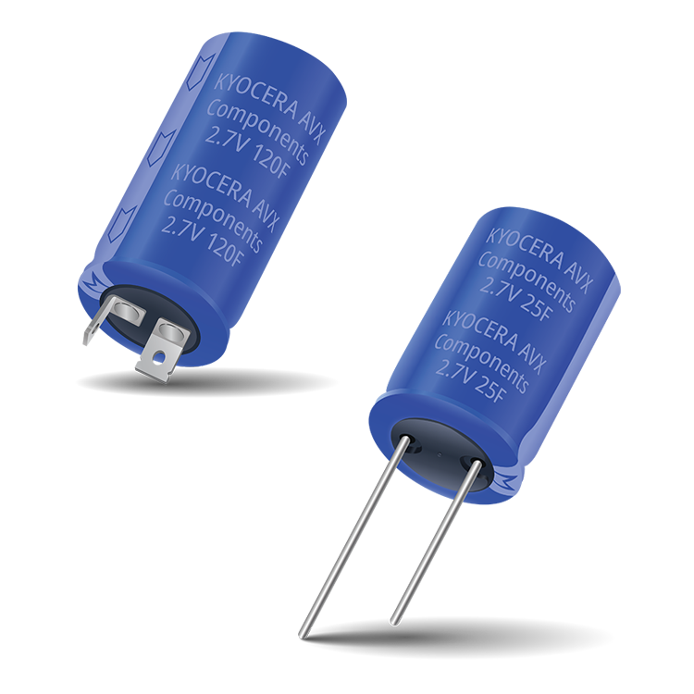
Components Requires
Hardware layer

Slide 8
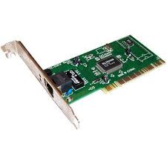
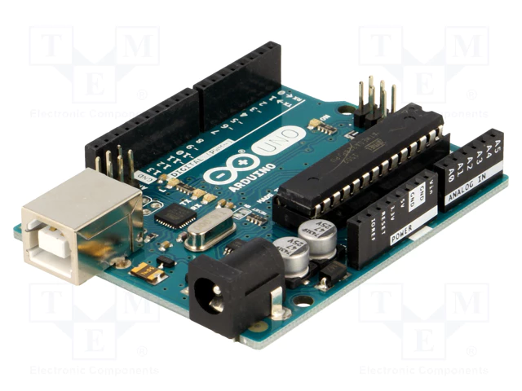

Components Requires
Network Layer

Slide 9



Components Requires
Application Layer

Slide 10
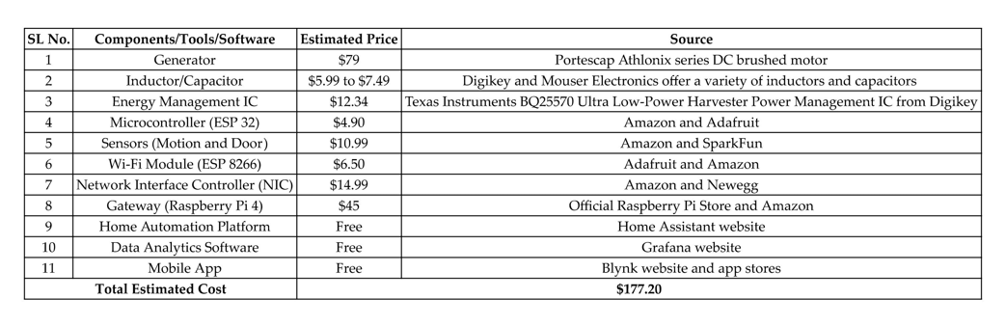
Budget

Slide 11

Milestone Map

Slide 12
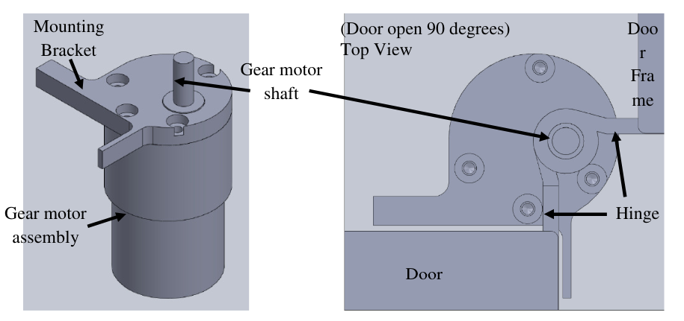

Slide 13
Thank You

